Slide 1
Brač,
In the shoes of Hercules…
www.bračhercules.com

Slide 2
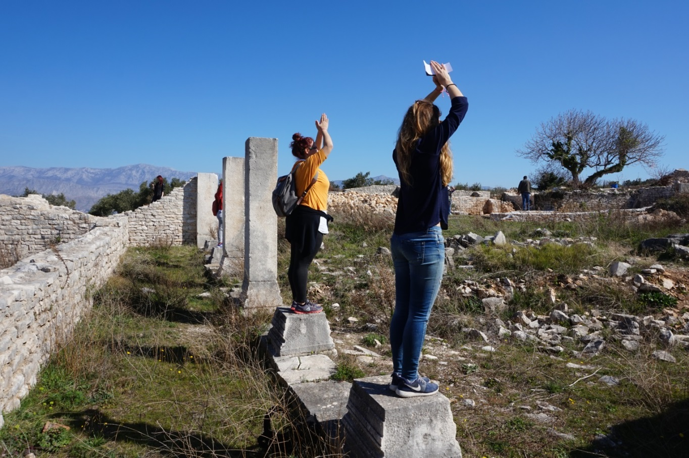
brač, in the shoes of hercules… a social entreprise
Find active experiences and contribute to the preservation of the island!
We will use the 40% of our profits to restore and valorize Brač heritage.

Slide 3
brač, in the shoes of hercules… Our website
E-Shop
Local products
Active experiences
Hercules’ job
Hercules’ efforts
Hercules’ lifestyle

Slide 4
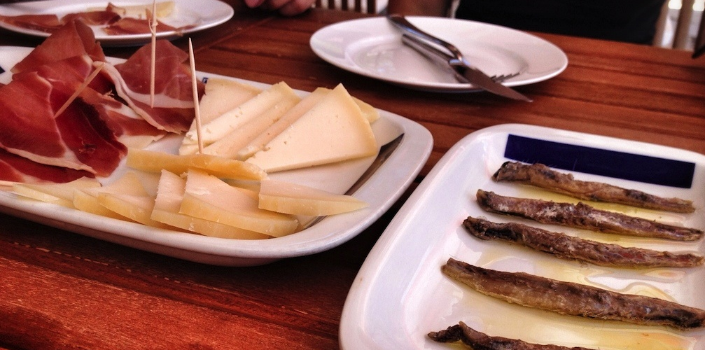
brač, in the shoes of hercules… e-shop
Local production

Slide 5
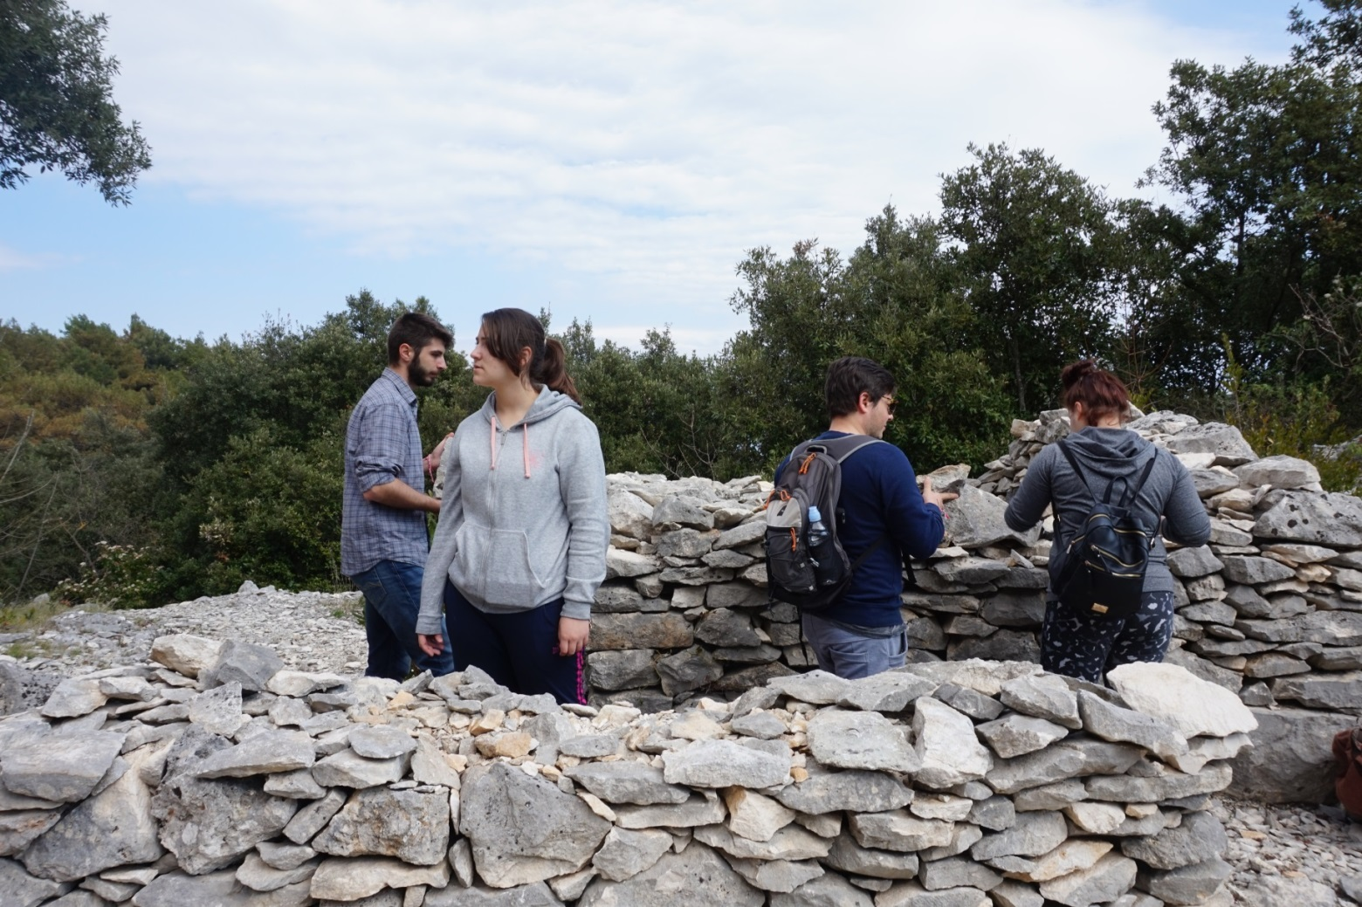
brač, in the shoes of hercules… active experiences
Hercules’ job: stone from quarry to sculptures

Slide 6
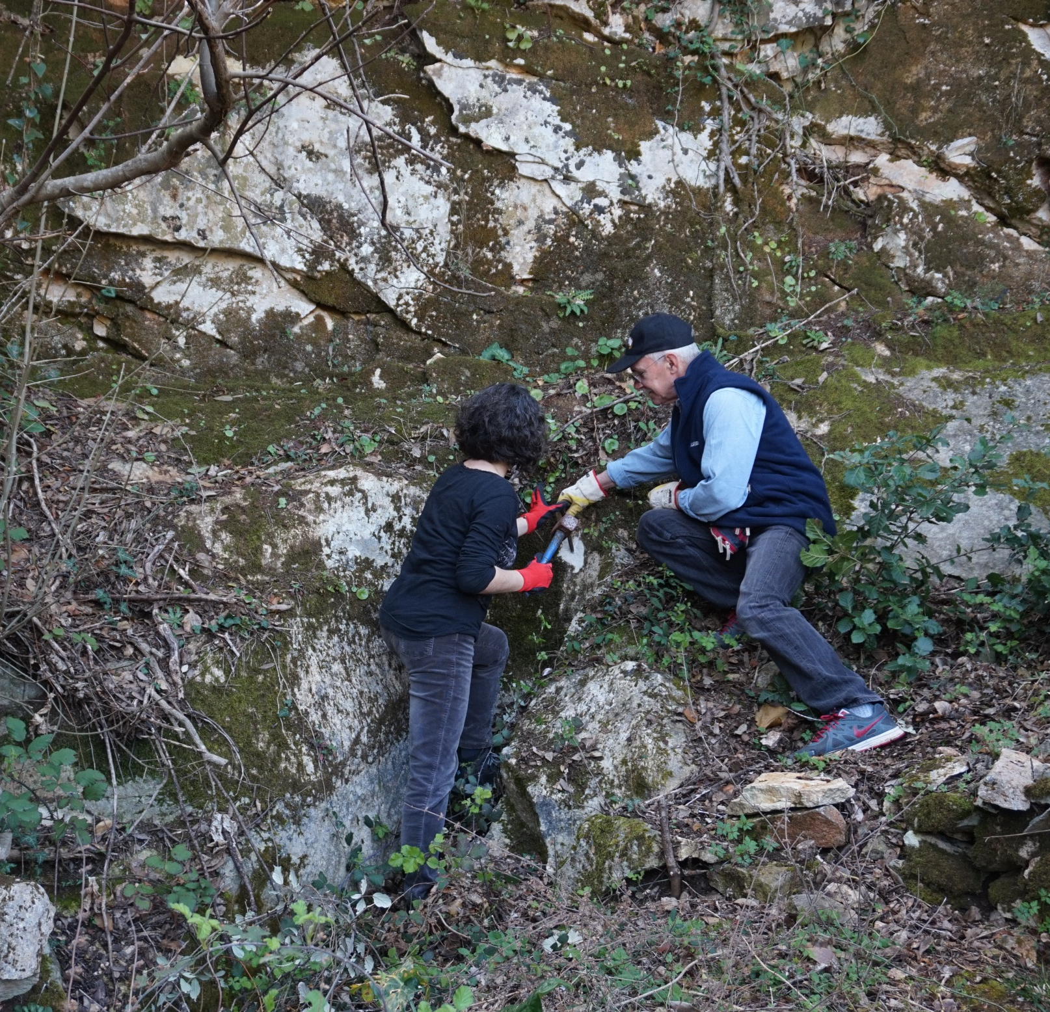

Slide 7
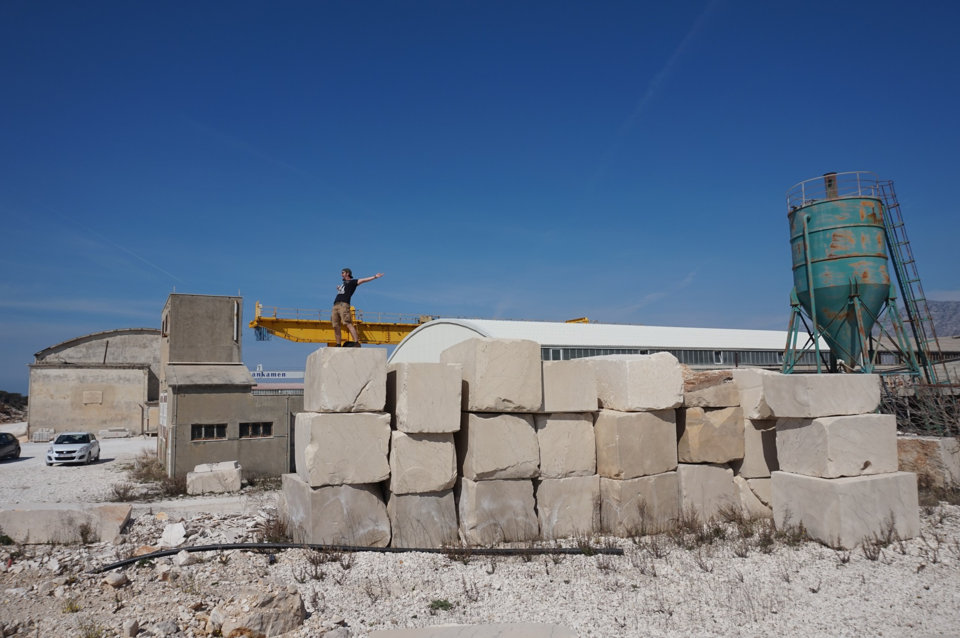

Slide 8
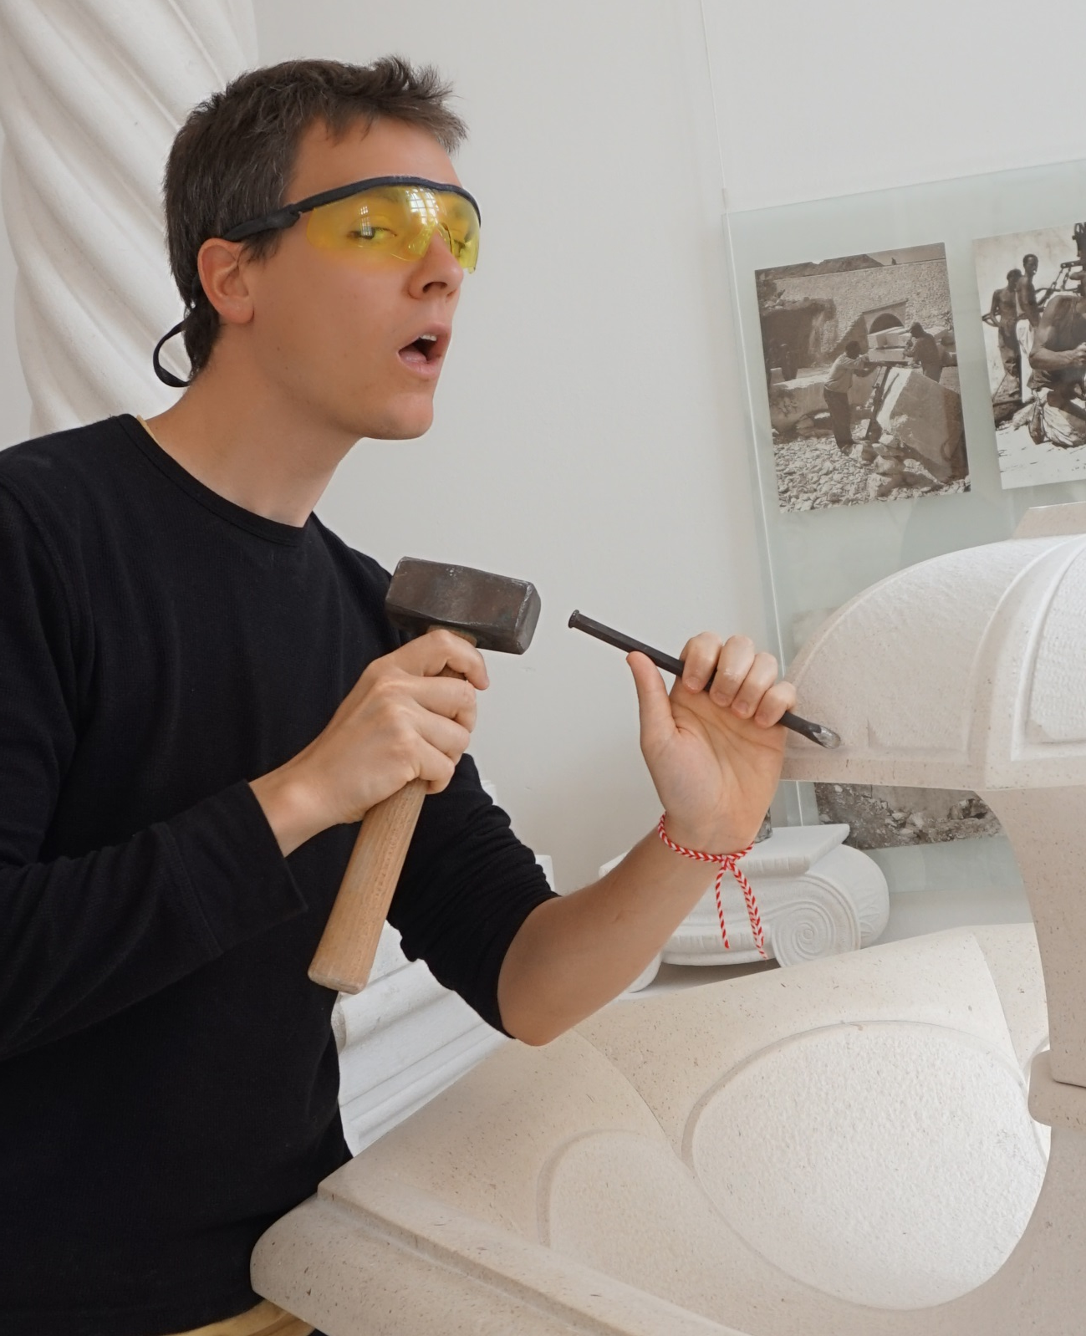

Slide 9
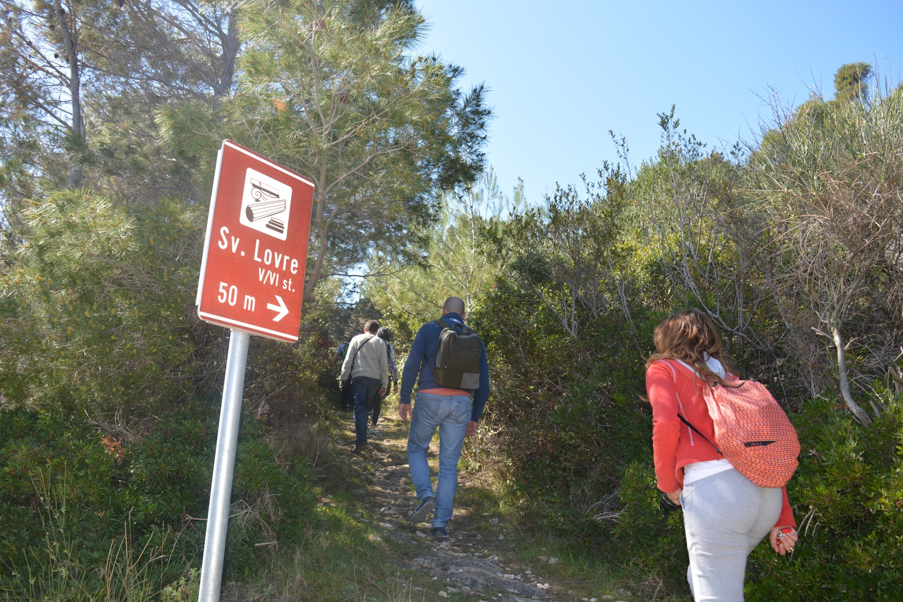
brač, in the shoes of hercules… active experiences
Hercules’ efforts: nature and sports

Slide 12
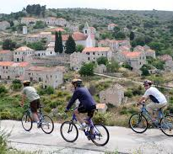
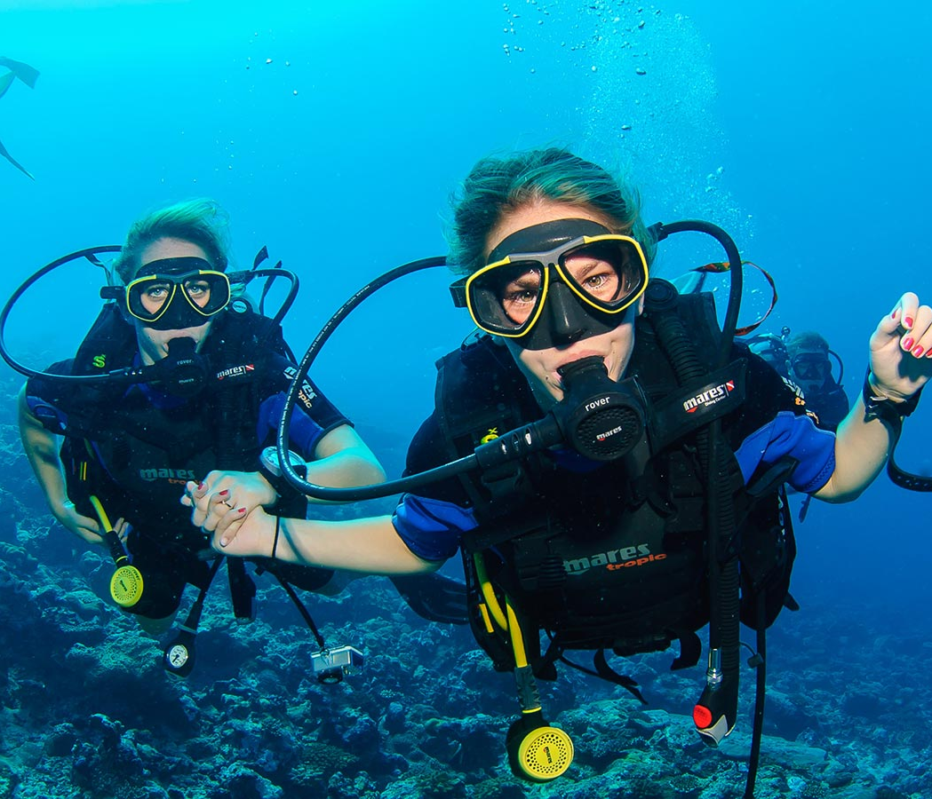
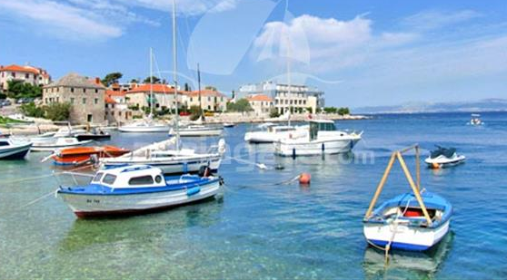

Slide 13
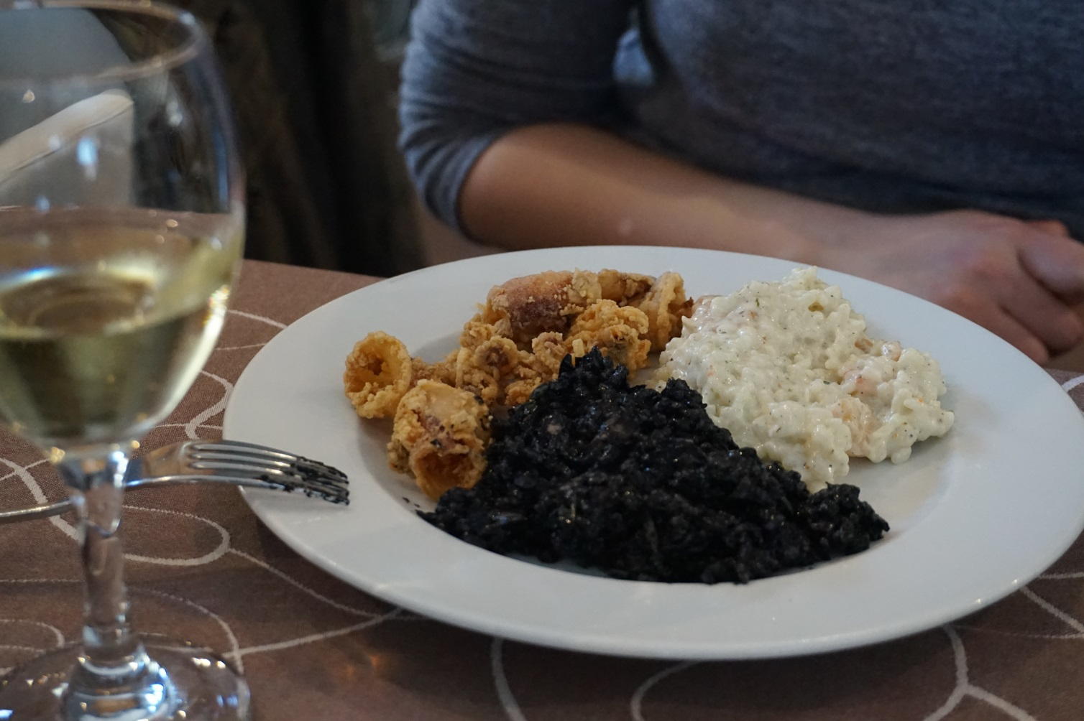
brač, in the shoes of hercules… active experiences
Hercules’ habits: Brač lifestyle and traditions

Slide 14
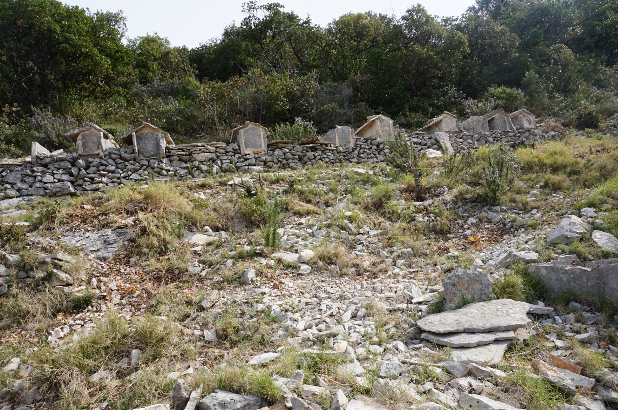

Slide 16
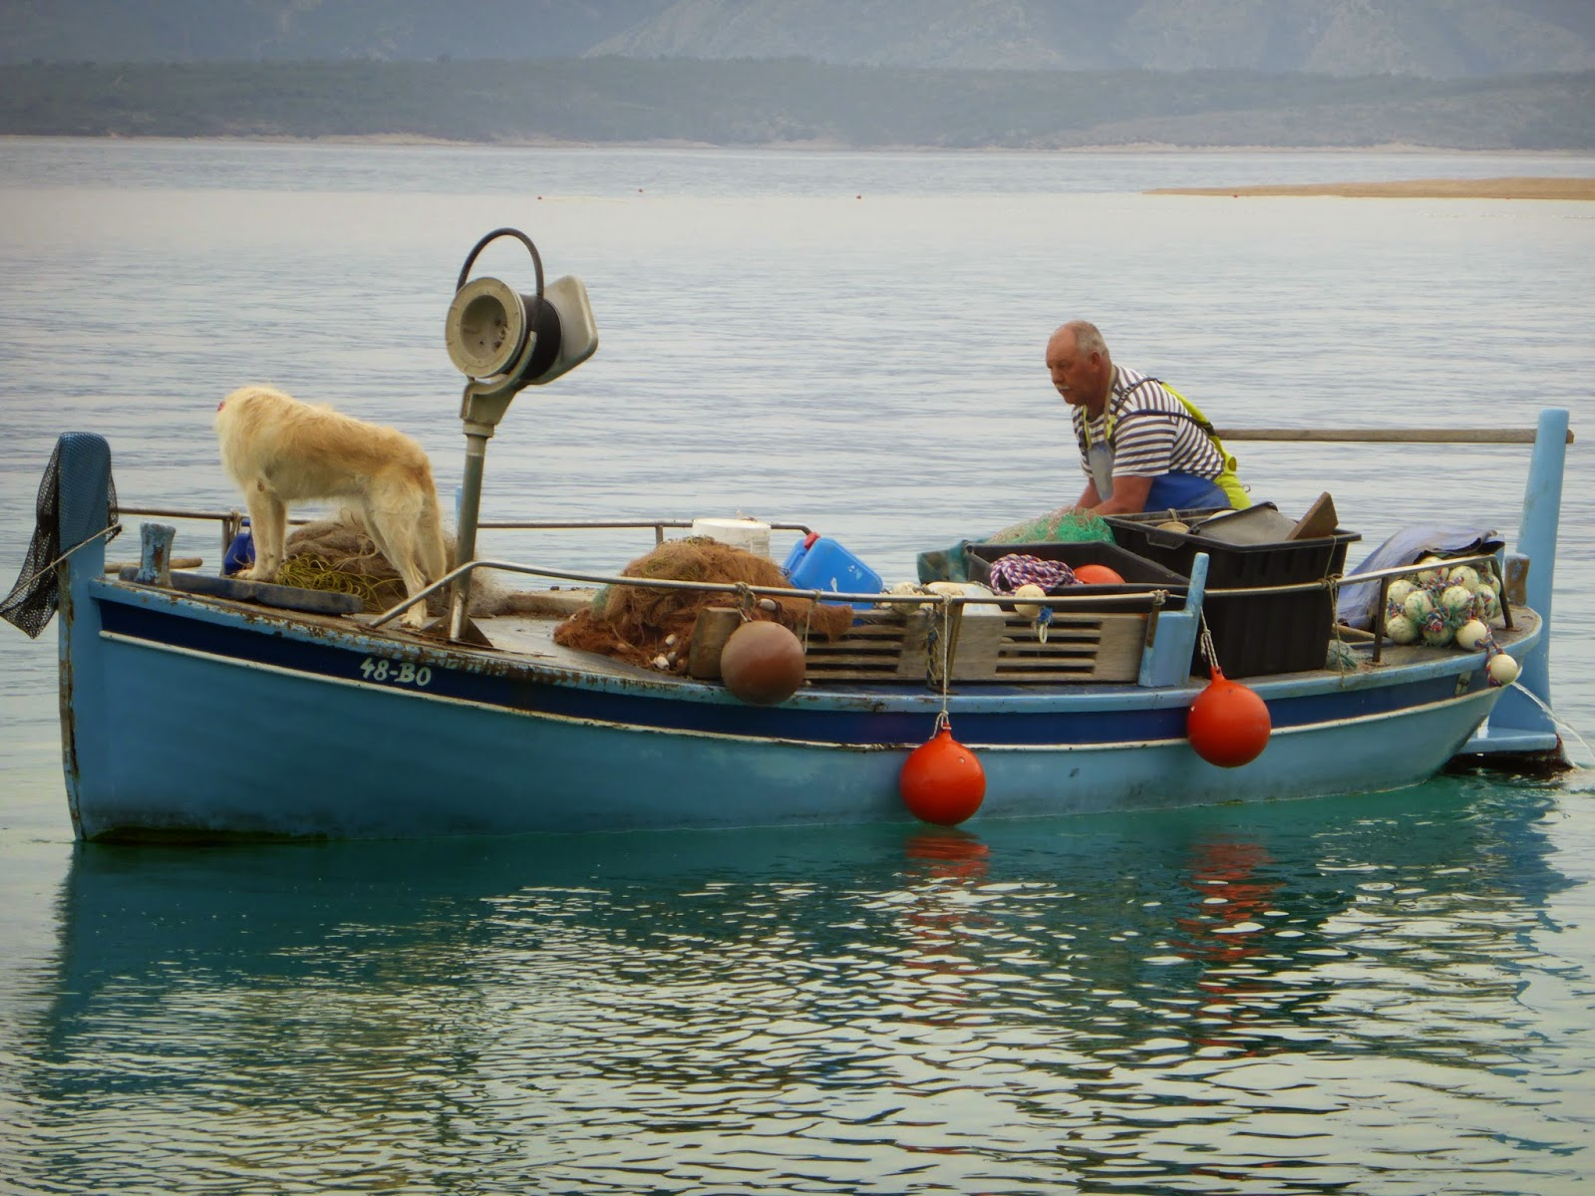

Slide 17
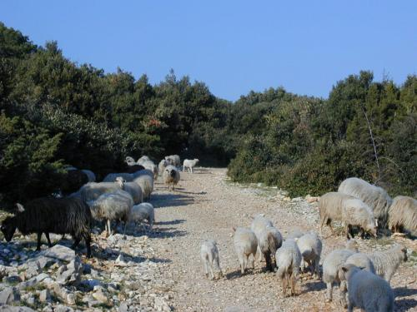

Slide 18
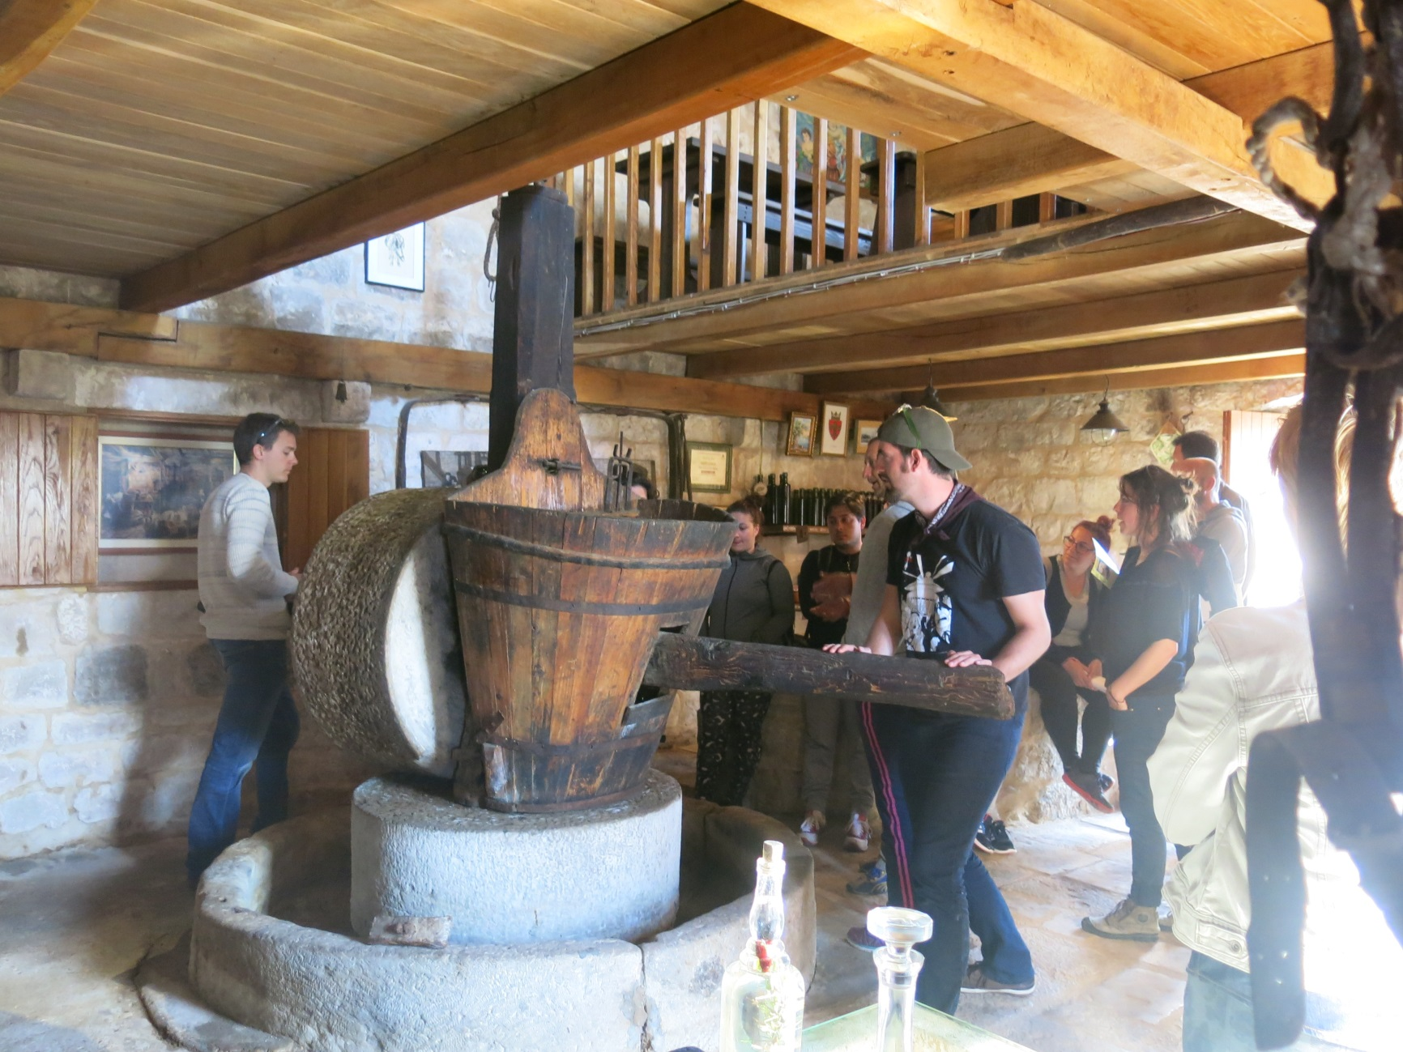

Slide 19
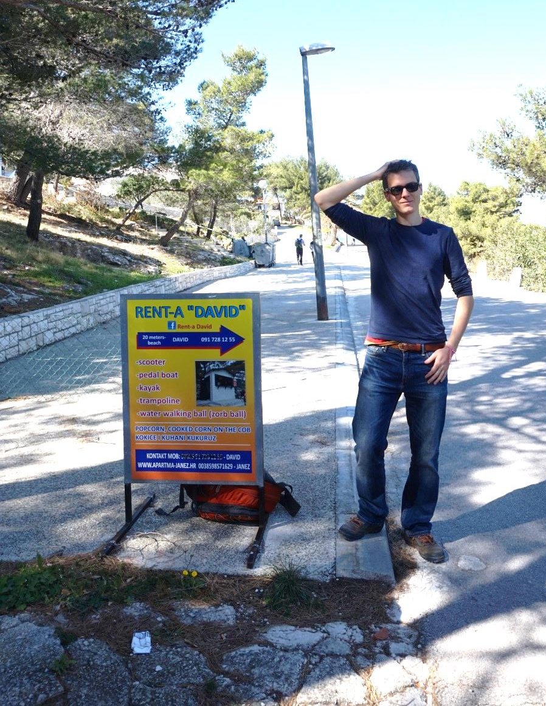
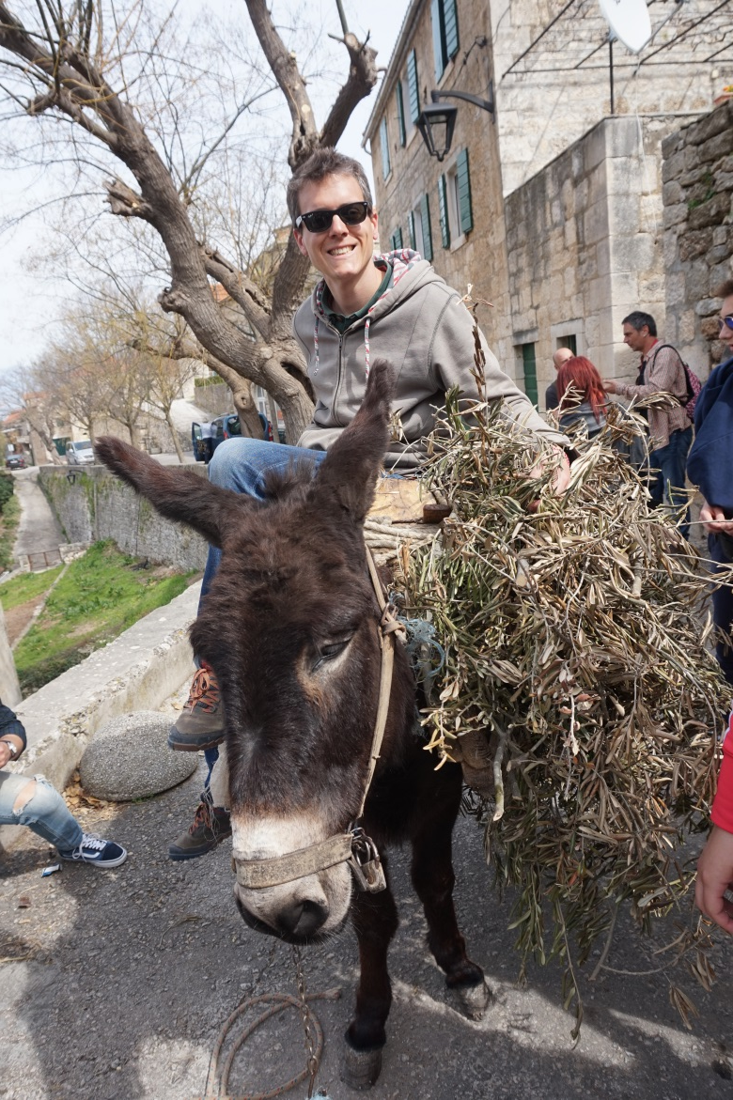
brač, in the shoes of hercules… sustainable transportation

Slide 20
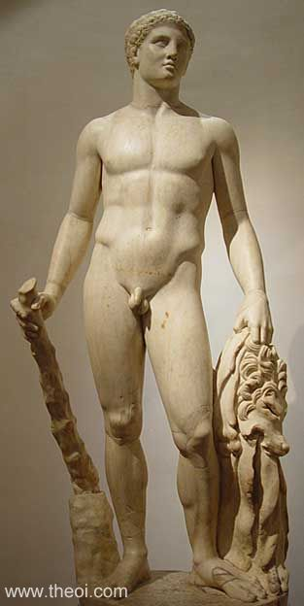
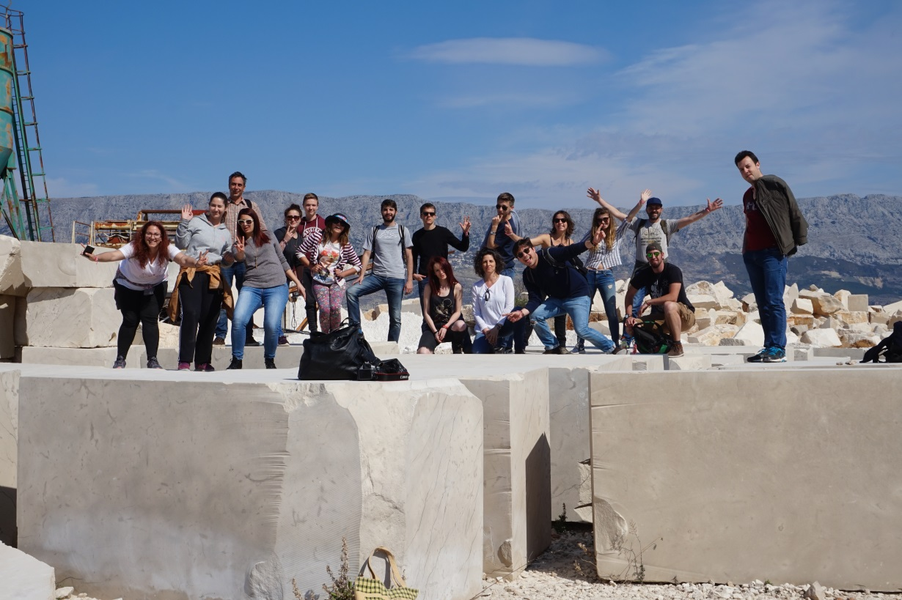
Better than spinach, visit Brač!
Is a funny and amazing experience, perfect for your mental and physical health

